Slide 1
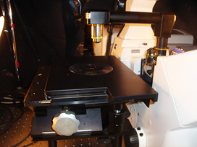
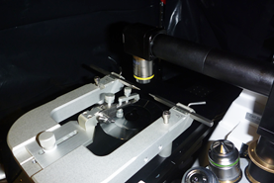
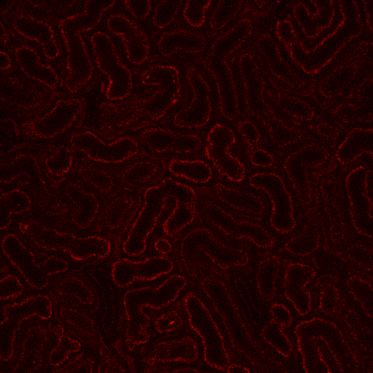
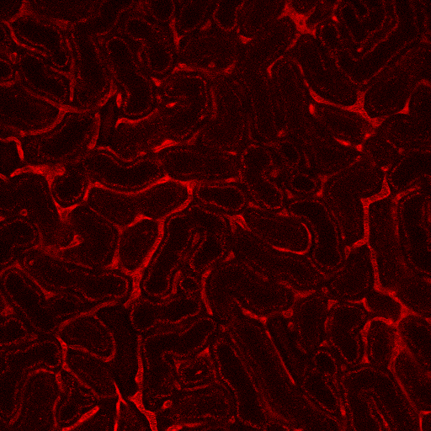
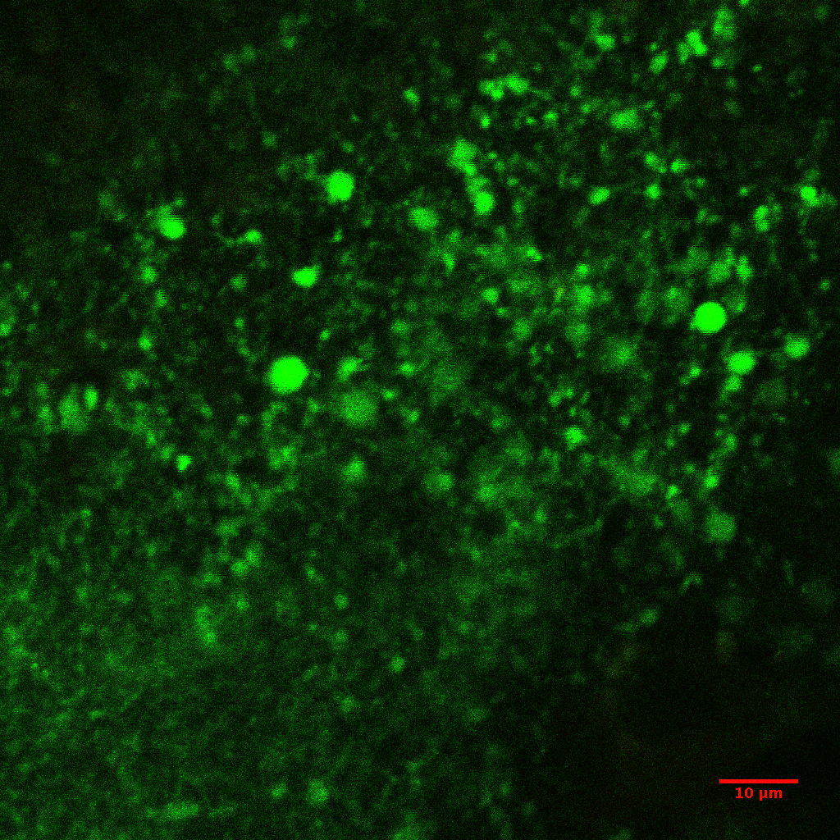
Intravital Imaging set up
Objective converter and custom stage
Objective converter and stereotaxis instrument
Live rat kidney before (left) and after (right) injection of fluorescent dextran.
(Mark Okusa’s lab, Medicine: Nephrology)
GCaMP3 expressing transgenic mouse – 40X water immersion – 880nm excitation – below surface (Mark Beenhakker’s lab)

